Slide 1
Analysis of decisionmaking processes through quantitative and qualitative discourse analysis
-
the case of ICANN and human rights

Slide 2
Why are we doing this?
Following Susan Leigh Star’s (1999) “call to study boring things”,
Internet is governed more than people think
This happens in multistakeholder fashion
Decisions are made on mailinglists
Let's analyse!

Slide 3

Where?

Slide 4
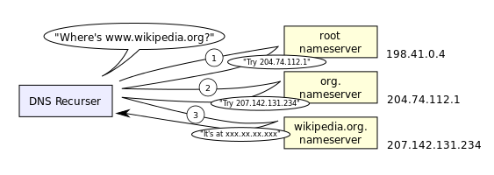

Slide 5
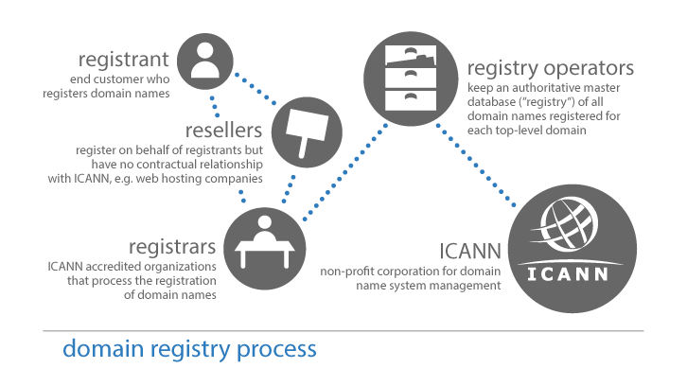

Slide 6
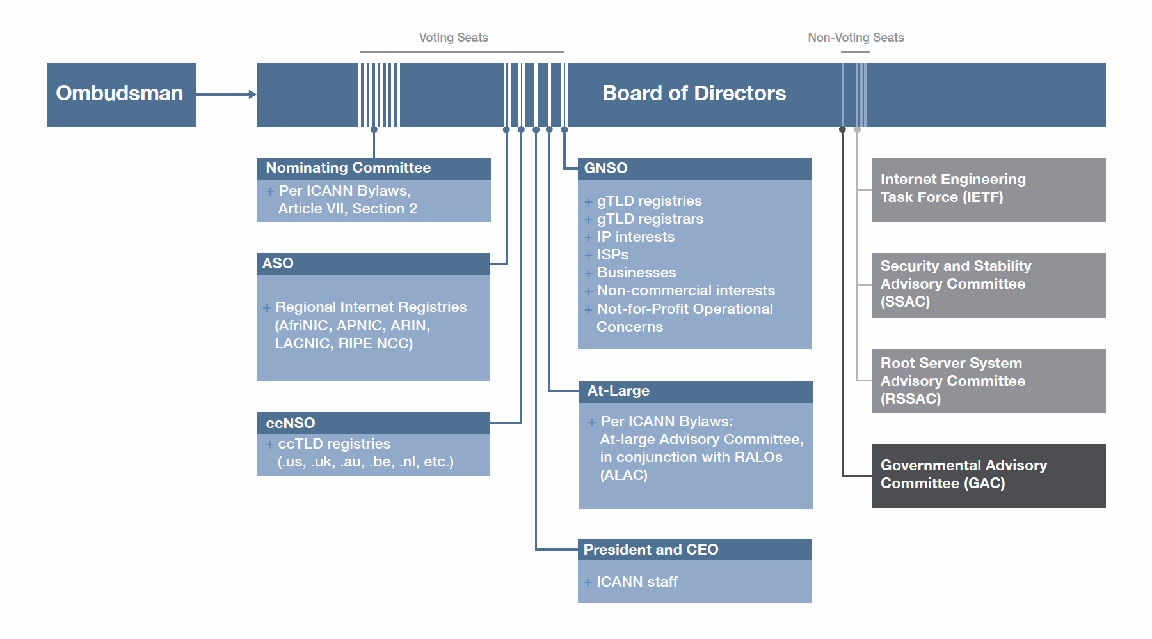

Slide 7
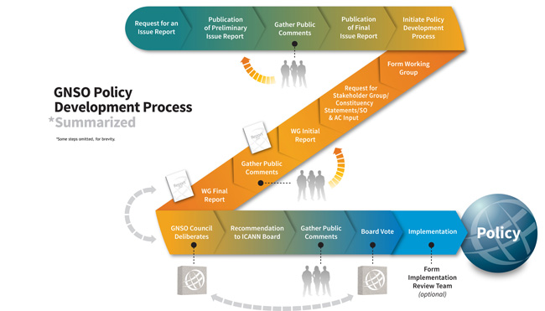

Slide 8
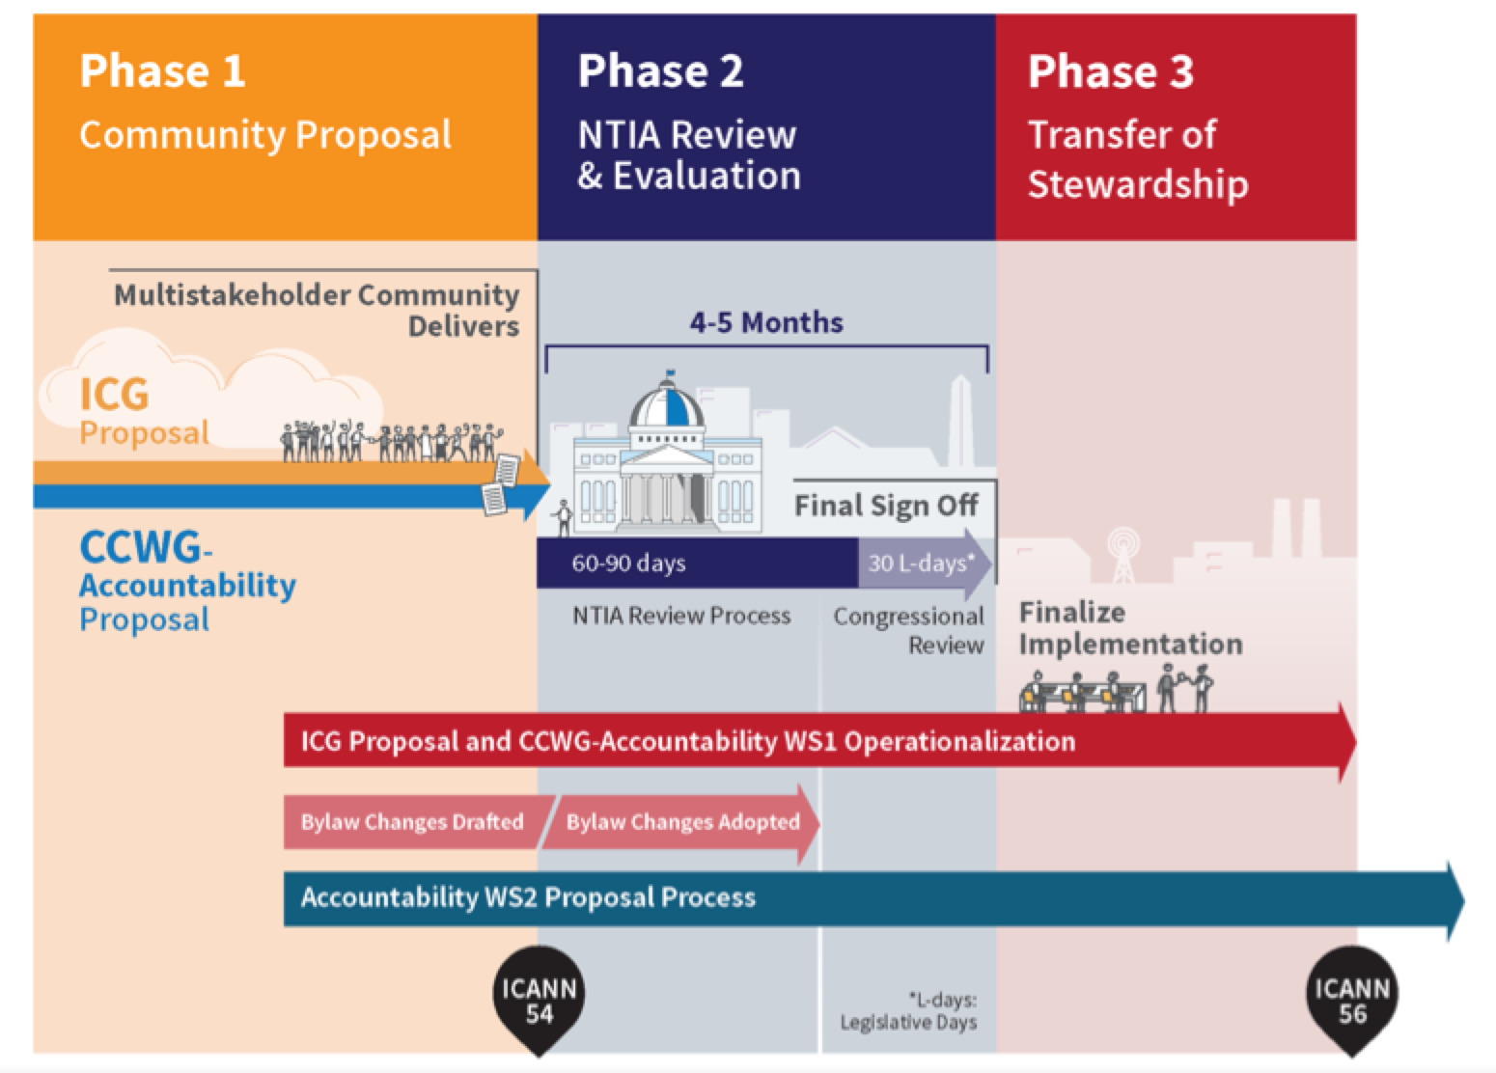

Slide 9
Why?
“ICANN is bound to operate “for the benefit of the internet community as a whole, carrying out its activities in conformity with relevant principles of international law and applicable international conventions and local law”
                - Article 4 of ICANN's Articles of Incorporation
ICANN's policies and operations have the potential to impact human rights

Slide 10




How?

Slide 11
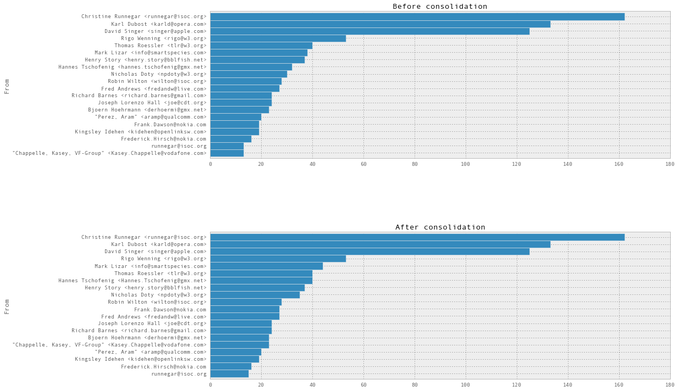
Analyse senders

Slide 12
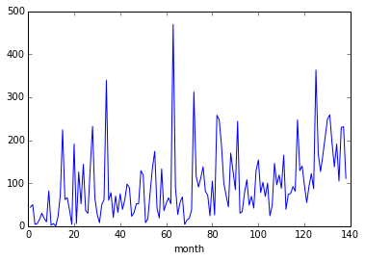
Single word trends

Slide 13
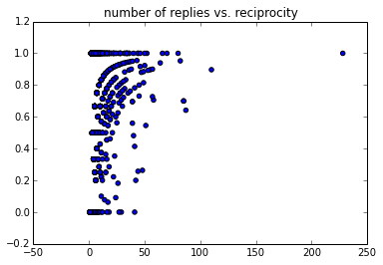
Collaboration Strength

Slide 14
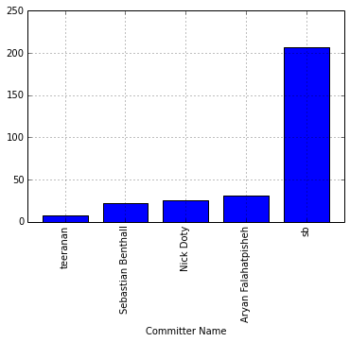
Committer dominance

Slide 15
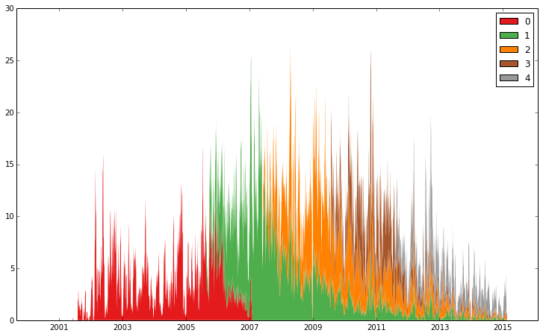
Cohorts

Slide 16

Assortativity

Slide 17
When?
Early 2000s up to now
Coming week

Slide 18
What will you get from this?
Understanding about ICANN
Working with Python Notebooks
Understanding of GIthub
Become part of BigBang development community

Slide 19
Who?
Sociologists
Computer scientists
Designers
Political scientists
Happy campers

Slide 20
Research Question
How the commitment to human rights made it into ICANNs bylaws?

Slide 21
Hypothesis
Debates on Human Rights were always present in ICANN, predominantly in the civil society / non-commercial constituency. But it did not get much response, so the rights agenda was pushed via single human rights such a the right to freedom of expression and the right to privacy, and later via social and economic rights. This paved the way for human rights in ICANN (which is now flourishing with a commitment to human rights in ICANNs bylaws.

Slide 22
References
ICANN Diagrams are produced by ICANN
www.icann.org

